Slide 1
Al-Anon Family Groups of Ohio, Inc.
Area World Service Committee &
Ohio Area Assembly Meetings
Meeting Etiquette
And the spiritual principles they demonstrate

Slide 2

Starting and stopping on time demonstrates integrity.

Slide 3

Stick to the Agenda
The spiritual principle of perseverance,
while conducting business in the best interest of all Al-Anon, preserves recovery at all levels.

Slide 4


Two minutes at the micro- phone.
During discussions, limiting our time at the microphone embodies the spiritual principles of humility and trust.

Slide 5

Stay on topic.
The spiritual principle of simplicity while we stay on topic, will help us reach our primary goal to help families and friends of alcoholics.
Notes:
The spiritual principle of simplicity while we stay on topic, will help us reach our primary goal to help families and friends of alcoholics.

Slide 6


If someone before you says what you were going to
say,….sit down.
Spiritual principles: efficient leadership and awareness.

Slide 7

No clapping, cheering, or booing, when opinions are shared ,
demonstrates mutual respect and creates an atmosphere of harmony.

Slide 8

The spiritual principle of courtesy is shown when we actively listen and form our own conclusions, leaving out reactions, opinions and judgments.
No side conversations.

Slide 9
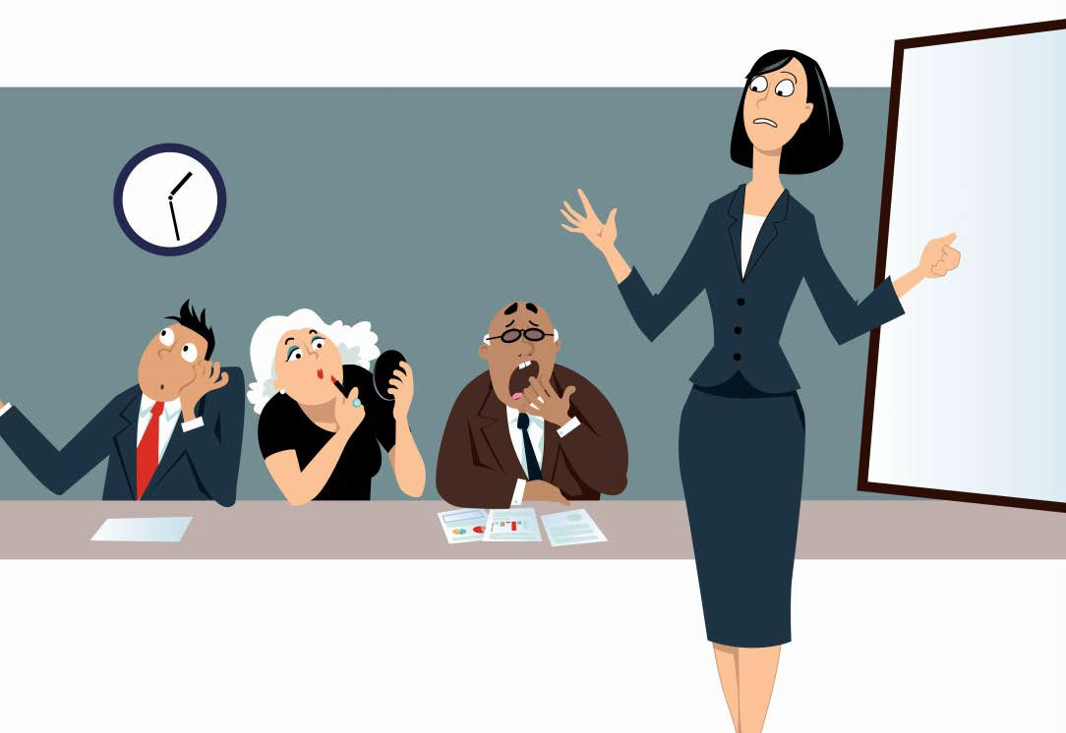
No miscellaneous distractions.
Show discipline and respect for the service commitments of those who have prepared for the meeting.

Slide 10

Keeping our cell phones muted demonstrates consideration for those around us as we focus on our meetings.

Slide 11

No perfumes or flowers. Be respectful and understanding of others

Slide 12

If you are unable to attend a session, notify the Chair. (one of the co-hosts during zoom session ☺)
Our spiritual principles of selflessness and dedication are evident when we do the right thing and are responsible to those we serve.
Keeping an accurate count of members present at a Meeting is essential during voting.

Slide 13

Practice spiritual principles
and presume goodwill.
By practicing humility, harmony
and unity, we can reach our ideals

Slide 14
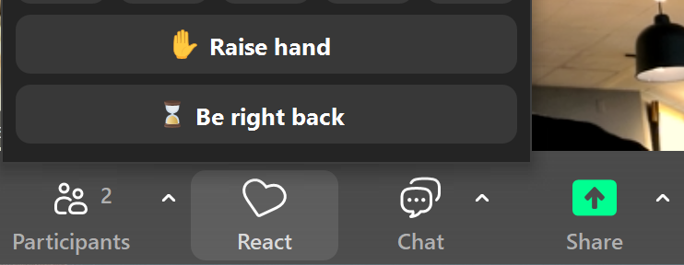
To Raise your hand, click on React and select Raise hand
To turn Chat
on or off,
Click on Chat

Slide 15
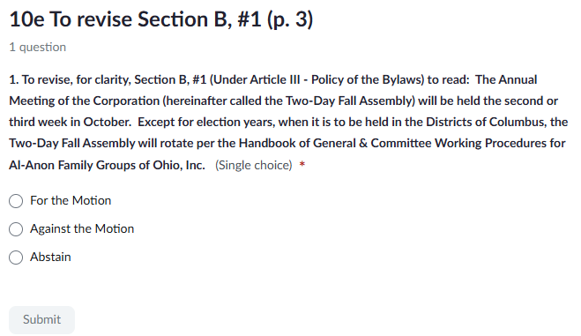
Voting on Zoom

Slide 16
BREAK TIME
Please return by 2:10 pm

