Slide 1
Al-Anon Family Groups of Ohio, Inc.
Area World Service Committee &
Ohio Area Assembly Meetings
Meeting Etiquette
And the spiritual principles they demonstrate
Notes:
I have adapted this from what was presented at my last WSC in 2020.
It is about obedience to the unenforceable and how we demonstrate respect, courtesy, mutual trust, and trust in our HP during our time together at a business meeting.

Slide 2

Notes:
Chairman responsibility
Starting and stopping on time demonstrates integrity.

Slide 3

Notes:
Stick to the Agenda – realizing that changes may need to be made.
The spiritual principle of perseverance, while conducting business in the best interest of all Al-Anon, preserves recovery at all levels.

Slide 4


Notes:
All must come to the mike to be recognized
Chairman will have asked for volunteer timer.
Two minutes at the microphone.
Questions first - show by raising the Service Manual.
Comments after questions answered
One followup question – who, what , how , why, when
Spiritual principles: efficient leadership and awareness.

Slide 5


Notes:
During discussions, limiting our time at the microphone embodies the spiritual principles of humility and trust.
If someone has already ask the question or stated your comment sit down

Slide 6

Notes:
Stay on topic
The spiritual principle of simplicity while we stay on topic will help us reach our primary goal to help friends and families of alcoholics.

Slide 7

Notes:
No clapping, cheering, or booing, when opinions are shared , demonstrates mutual respect and creates an atmosphere of harmony.
Clap for appreciation when reports given.
Not for opinions – which goes with the next slide.

Slide 8

Notes:
No side conversations.
The spiritual principle of courtesy is shown when we actively listen and form our own conclusions, leaving out reactions, opinions and judgments.

Slide 9
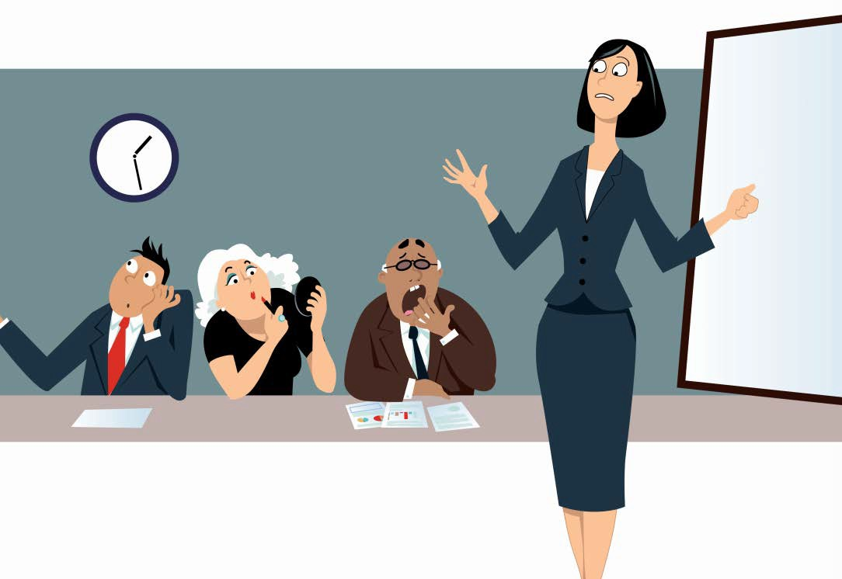
Notes:
No miscellaneous distractions.
Show discipline and respect for the service commitments of those who have prepared for the meeting.

Slide 10

Notes:
Keeping out cell phones muted demonstrates consideration for those around us as we focus on our meeting

Slide 11

Notes:
No perfumes or flowers. Be respectful and understanding of others

Slide 12

Notes:
We are all a piece of the puzzle. Let the registration chair know when you need to leave the room and when you have come back.
Keeping an accurate count of members present at a Meeting is essential during voting.
Our spiritual principles of selflessness and dedication are evident when we do the right thing and are responsible to those we serve.

Slide 13

Notes:
Practice spiritual principles and presume goodwill.
By practicing humility, harmony, and unity, we can reach our ideals
Your participation is valued
Your service is appreciated
Your presence is applauded

